Slide 1
Big Data Technology - CS523
Tweet Trend Watch
Prof. Mrudula Mukadam

Slide 2
Final Project
Submitted To: Prof. Mrudula Mukadam
Submitted By:
Baibing Song Iga Daniel Ssetimba
Sourav Babu Shrestha

Slide 3
Technologies Used
Centos 6.7
Hadoop 2.6.0
Java JDK 8
Eclipse Luna 4.4.2
Kafka_2.12-3.4.1
HBase 1.2.0
Hive 1.1.0
Spark 1.6.0
Tableau 2023.2

Slide 4
Project Overview
For this project, we retrieved the dummy Twitter tweets from the API in order further aggregate, filter and analyze them
Using the Kafka topic: kafka-spark, the message is produce from the Producer and consumed by the consumer
The tweets from Kafka are obtained using Spark streaming, and some filtering and aggregation are done such that the structured tweets are stored to an HBase Table
Spark SQL is used to analyze data that is stored in HBase, and the results are subsequently stored in HDFS
To perform result visualization, an HDFS Hive with External Table is created
The tool used to display results is Tableau Desktop

Slide 5
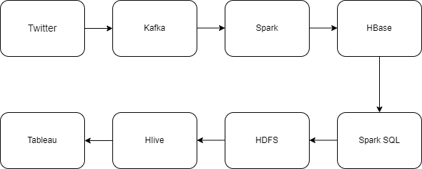
Project WorkFlow

Slide 6
Modules developed for this Project
BDT-Kafka-Producer
Fetch the dummy tweets from the API
Once the data is fetch, Kafka Producer send the tweets to Kafka Producer
Zookeeper should be up and running for the Kafka to be in operation

Slide 7
Modules developed for this Project
BDT-SparkKafka-Consumer
This module consume tweets from the Kafka Producer and pass the tweets to Spark for further processing
Spark aggregation and filter is done based on the keywords defined in HBase Table
Stored the aggregated and filtered tweets into the HBase Table

Slide 8
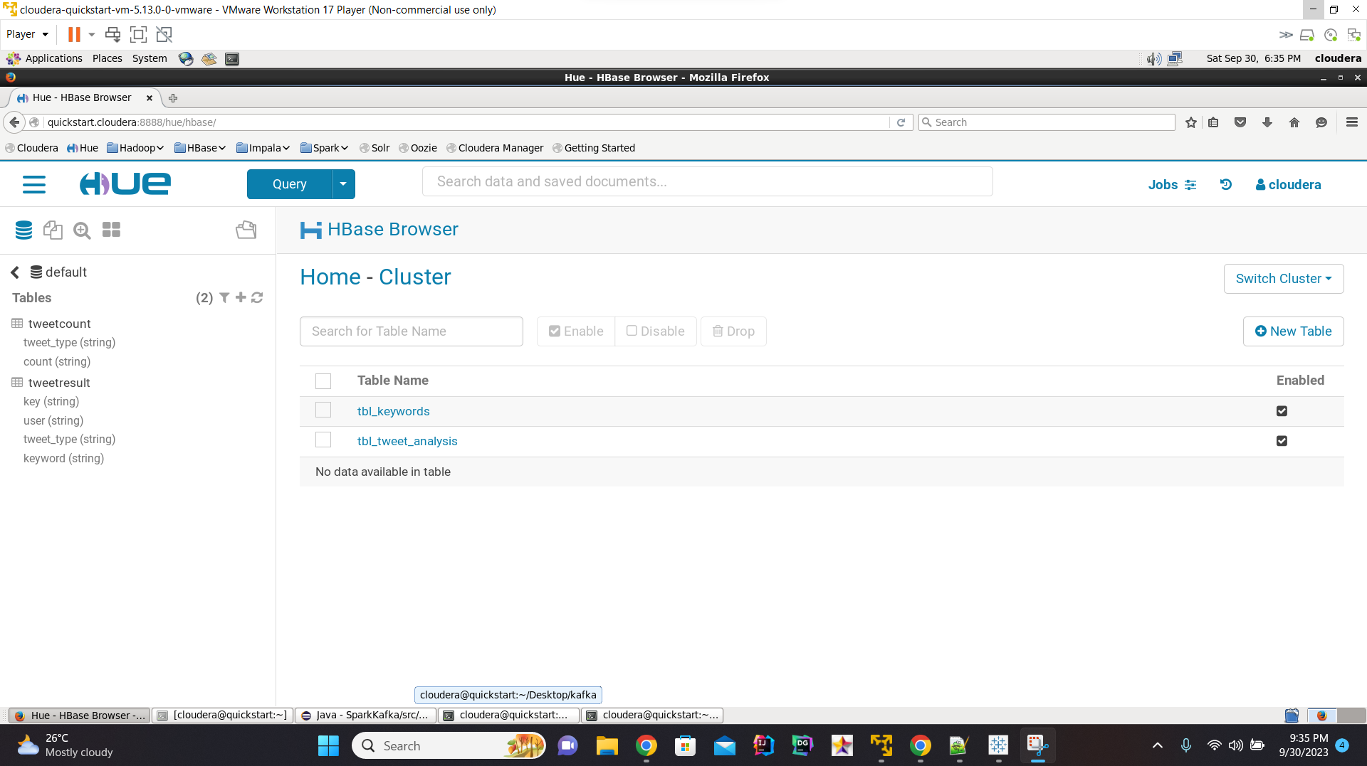

Slide 9
Modules Developed for this Project
BDT-SparkSQL-Generator
This module fetch the data stored in HBase and perform Spark SQL queries like grouping by keywords, counts, etc.
Store the result in CSV file to HDFS which is then consumed by the External Hive Table

Slide 10
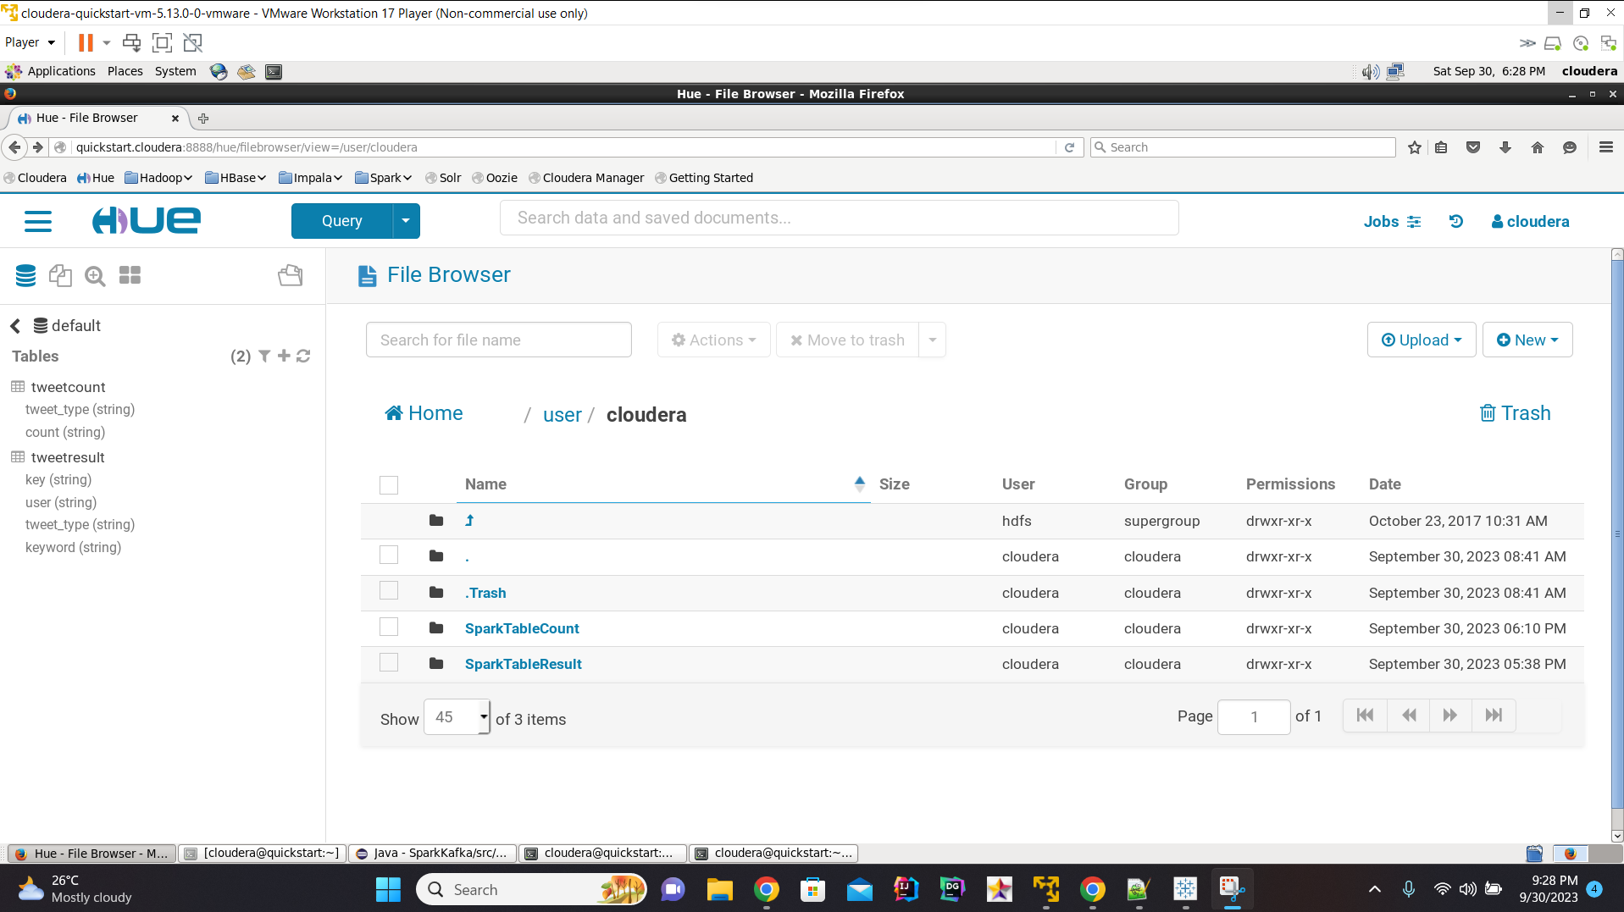

Slide 11
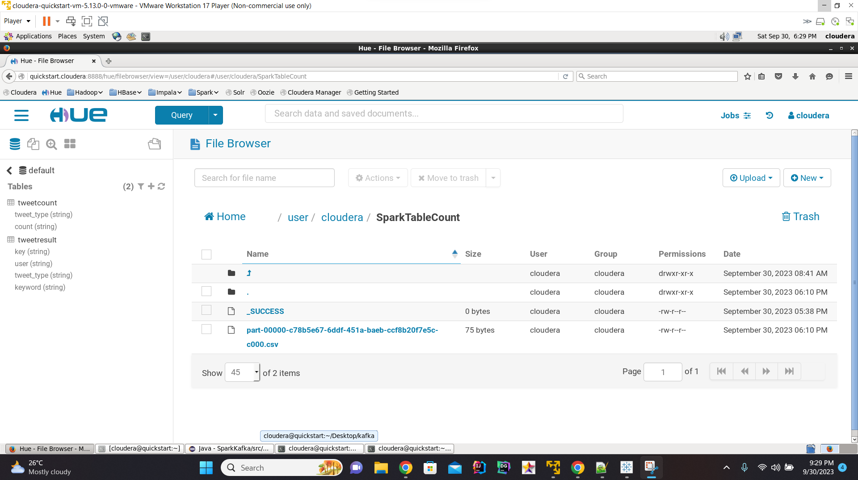

Slide 12
Hive Table External Command
hive> CREATE EXTERNAL TABLE TweetCount (tweet_type String, count INT) COMMENT 'Spark Hive Tale' ROW FORMAT SERDE 'org.apache.hadoop.hive.serde2.OpenCSVSerde' WITH SERDEPROPERTIES("SEPERATOR" = ",", "QUOTECHAR"="\"", "ESCAPECHAR"="\"") STORED AS TEXTFILE location '/user/cloudera/SparkTableCount'TBLPROPERTIES("skip.header.line.count"="1"); Time taken: 8.296 seconds
hive> CREATE EXTERNAL TABLE TweetResult (key String, user String, tweet_type String, keyword String) COMMENT 'Spark Hive Tale' ROW FORMAT SERDE 'org.apache.hadoop.hive.serde2.OpenCSVSerde' WITH SERDEPROPERTIES("SEPERATOR" = ",", "QUOTECHAR"="\"", "ESCAPECHAR"="\"") STORED AS TEXTFILE location '/user/cloudera/SparkTableResult'TBLPROPERTIES("skip.header.line.count"="1");
OK Time taken: 0.244 seconds hive> show tables; OK Tweetcount Tweetresult Time taken: 0.02 seconds, Fetched: 2 row(s)

Slide 13
Tableau
We have used Tableau Desktop for to represent the data stored in Hive External Table
Tableau connect with Cloudera Hadoop using ODBC client
Fetch the data from Hive External Table
Generate the graphs to show the analysis in more meaningful way

Slide 14
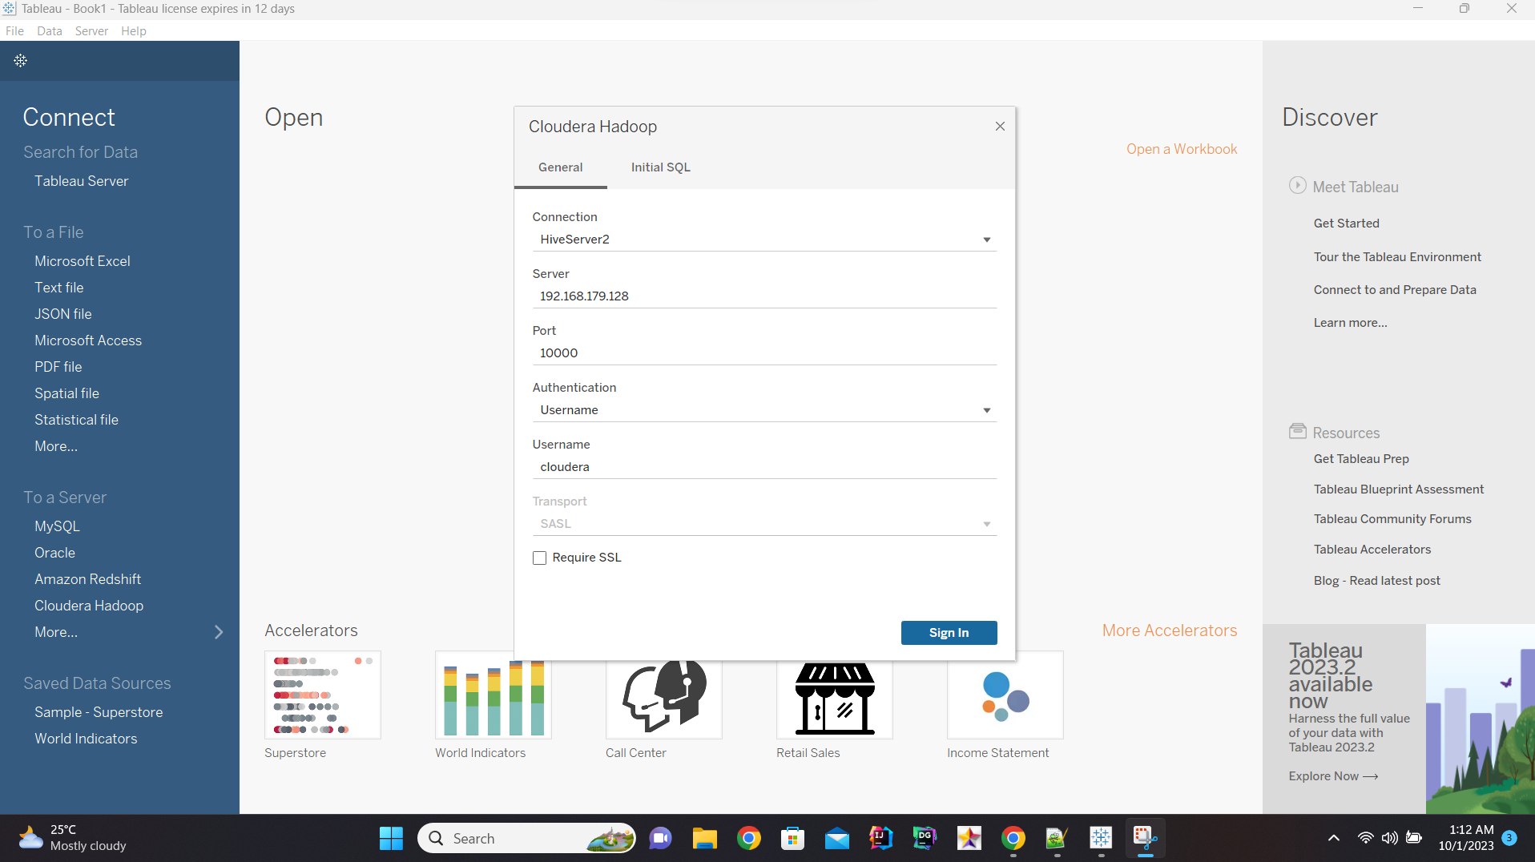

Slide 15
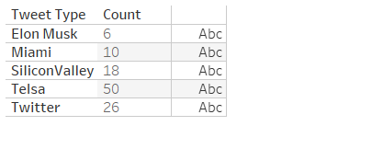
Tableau Graphs

Slide 16
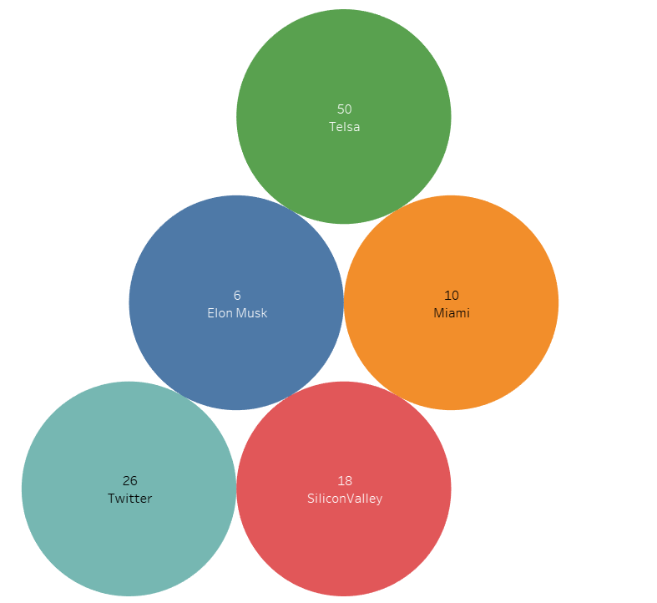

Slide 17
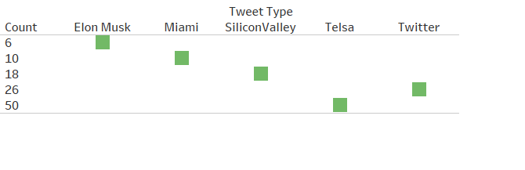
Tableau Graph

Slide 18
Kafka Command used for this Project
./bin/zookeeper-server-start.sh config/zookeeper.properties -> start zookeeper
./bin/kafka-server.start.sh config/server.properties ->start kafka server
./bin/kafka-topics.sh --create --topic kafka-spark --replication-factor 1 --partitions 1 --bootstrap-server localhost:9092 -> create topic

Slide 19
Operation Breakdown
Step 1: Create dummy Twitter Tweet API
Step 2: Download Kafka from kafka/downloads.html
Step 3: Start zookeeper, start Kafka and create Kafka topic
Step 4: Run Kafka consumer Java application to produce tweets
Step 5: Run Spark-Consumer Java Program to consume tweets and store in HBase

Slide 20
Operation Breakdown
Step 6: Create Hive External DB using the above create table command
Step 7: Run Spark SQL Java program to store Tweets in HDFS and also create CSV file
Step 8: Connect Tableau with Cloudera Hadoop using ODBC
Step 9: Fetch data from Hive External Data i.e CSV file
Step 10: Generate different graphs using the CSV data and Tableau desktop app

Slide 21
Wholeness of Project
For this project, we used the tweets and ran analyses on them using a variety of technologies, including Kafka, Spark, Hive, Tableau, etc. Following analysis, we create the graphs for better understanding the data by integrating with Tableau.
Science and Technology of Consciousness: We regularly practice transcendental meditation since everything is made up of layers and to learn more about the unified field of consciousness. After engaging in Transcendental Meditation, we are able to see its beneficial consequences on our day-to-day lives, frequently with the help of nature.

Slide 22

Thank You !!!
Excited to leverage our enhance Big Data skills on new challenges ahead.

